Slide 1
Multi -variate regression analysis using machine learning.

Slide 2
Abstarction
Predicting the user response plays a vital role in presenting relevant ad to the right audience.
It involves the impact of the metrics in measuring the ad effectiveness.
insight to the research areas which are to be focused for better serving community in future where social media and mobile app users are increasing drastically every day.

Slide 3
introduction
Increased device utilization and enhanced online user an activity predicting the user response plays a vital role in resenting relevant ad to the right audience.
It will help the advertisers in analyzing the requirements and the interests of the customers and enhance their advertising approach and ad company strategy thus it becomes essential to predict the number of clicks gained by the advertisements.
we find the dependencies of independent values (expenditure on adds) and dependent values (sales outcome) for an car advertising company and hence analyzing the cost effectiveness upon sales using regression analysis.

Slide 4
Literature survey
To estimate growth in sales of a company based on current economic conditions.
You have the recent company data which indicates that the growth in sales is around two and a half times the growth in the economy.
Using this insight, we can predict future sales of the company based on current & past information.

Slide 5
Literature survey
To establish a relationship between dependent variable (Y) and one or more independent variables (X) using a best fit straight line (also known as regression line).
It is represented by an equation Y=a+b*X + e, where a is intercept, b is slope of the line and e is error term. This equation can be used to predict the value of target variable based on given predictor variable(s).

Slide 6
features
TV: Advertising dollars spent on TV for a single product in a given market (in thousands of dollars)
Radio: Advertising dollars spent on Radio
Newspaper: Advertising dollars spent on Newspaper

Slide 7
response
Sales: sales of a single product in a given market (in thousands of widgets)
There are 200 observations, and thus 200 markets in the dataset.

Slide 8
Software requirements:
Anaconda navigator as an applications wrapper hub
Spyder as GUI interface for coding
Libraries required:
Pandas
Matplotlib
Sklearn.liner_model

Slide 9
Hardware requirements:
Processor i3 and above
Ram 4gb and above

Slide 10
TV
response
Radio
Sales
response
Newspaper
response

Slide 11
Considering a dummy variables to understand the concept clearly.

Slide 12
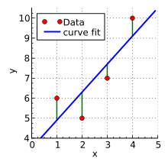
Now consider each point, and know that each of them have a coordinate in the form (X,Y). Now draw an imaginary line between each point and the current "best-fit" line. We'll call the distanace between each point and the current best-fit line as D.

Slide 13
Head
 | TV | radio | newspaper | sales
1 | 230.1 | 37.8 | 69.2 | 22.1
2 | 44.5 | 39.3 | 45.1 | 10.4
3 | 17.2 | 45.9 | 69.3 | 9.3
4 | 151.5 | 41.3 | 58.5 | 18.5
5 | 180.8 | 10.8 | 58.4 | 12.9

Slide 14
Tail
 | TV | radio | newspaper | sales
196 | 38.2 | 3.7 | 13.8 | 7.6
197 | 94.2 | 4.9 | 8.1 | 9.7
198 | 177.0 | 9.3 | 6.4 | 12.8
199 | 283.6 | 42.0 | 66.2 | 25.5
200 | 232.1 | 8.6 | 8.7 | 13.4

Slide 15
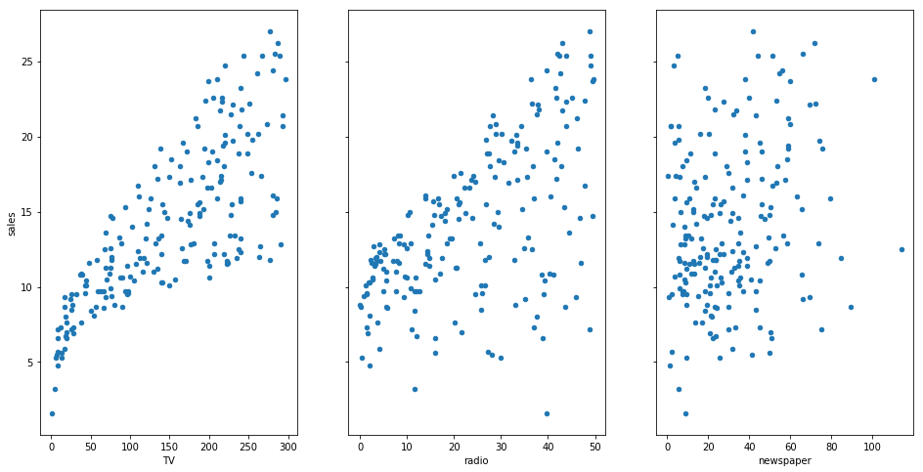

Slide 16
ordered relationship
 | TV | radio | newspaper | sales | Size | IsLarge | Area | Area_suburban | Area_urban
1 | 230.1 | 37.8 | 69.2 | 22.1 | large | 1 | rural | 0 | 0
2 | 44.5 | 39.3 | 45.1 | 10.4 | small | 0 | urban | 0 | 1
3 | 17.2 | 45.9 | 69.3 | 9.3 | small | 0 | rural | 0 | 0
4 | 151.5 | 41.3 | 58.5 | 18.5 | small | 0 | urban | 0 | 1
5 | 180.8 | 10.8 | 58.4 | 12.9 | large | 1 | suburban | 1 | 0

Slide 17
Here is how we interpret the coding:
rural is coded as Area_suburban=0 and Area_urban=0
suburban is coded as Area_suburban=1 and Area_urban=0
urban is coded as Area_suburban=0 and Area_urban=1

